Slide 1
Repliclade: A Simulator of sequence evolution in gene families
Presented by haki dehari

Slide 2


Introduction
Master’s in Computer Science
Inter-disciplinary nature of project
Working knowledge of theoretical concepts was desired
Phylogenetic Theory
Population Genetics
Foundational knowledge needed in both fields
Goal was to create something of value in both fields
Explanation of concepts in Population Genetics and Phylogenetic Theory is needed
Notes:
During the course of my Master's research project I learned that I would need to utilize or develop a range of computational tools, as one would expect from a Master's thesis in computer science. However, because this project project is interdisciplinary in nature, I also had to acquire a working knowledge of numerous theoretical concepts in the related fields of population genetics and phylogenetic theory. Importantly, I wanted to gain a solid understanding of theoretical concepts and analytic methods in both fields, so that - in the end - I could create something of genuine value to workers in both fields. I will endeavor to explain both integral computational and bioinformatics concepts during my presentation.

Slide 3

Introduction - Bioinformatics
Simulation of sequence evolution
Filled with novel algorithms and programs
Tackles the problem from a variety of different angles
Vital need for a program like Repliclade
A set of evolutionary models
These incorporate mathematical models within them
Some are more accurate than others
Important to give the user a choice

Slide 4
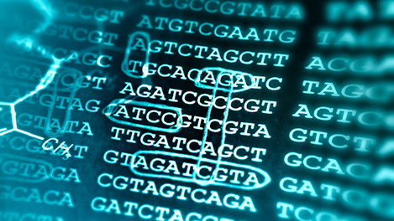
Introduction – Bioinformatics continued
Direct observation is still the preferred method of sequence parameter extraction
There are also various ways to extract sequence characteristics via probabilistic and computational methods
By looking at related genes to the original sequence, one can extract various parameters
For example, mutation rate and effective population size
There are not many tools or programs which currently do this
one must dig through stacks of literature to isolate the best methods for sequence parameter extraction

Slide 5

Previous work - Model test
ModelTest (Posada and Crandall, 1998)
Selects best fit nucleotide substitution model for aligned sequences
Uses likelihood ratio tests
Incredibly useful to select a model for phylogenetic analysis
Repliclade is similar
Instead, it provides tool for ancestral sequence inference
Provides scores for best fit evolutionary models in regards to the ancestral sequence

Slide 6
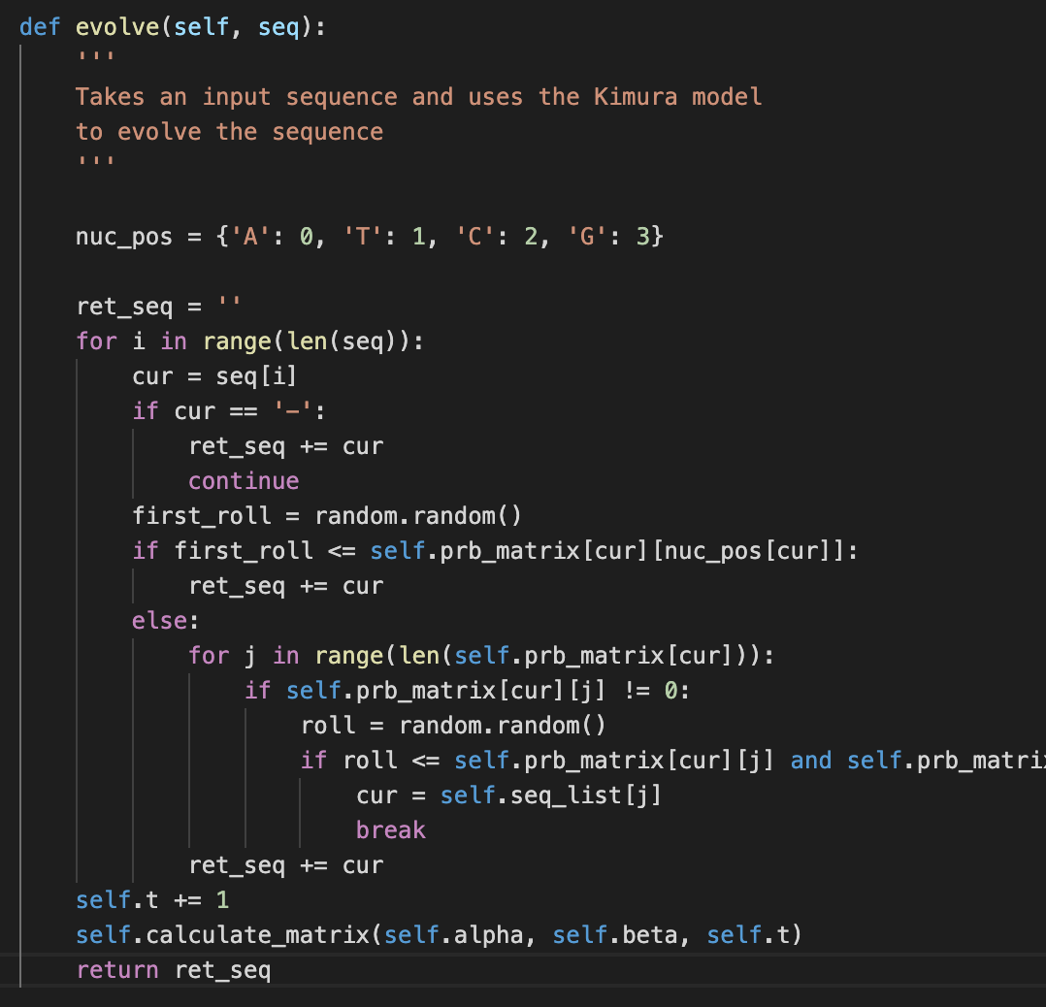
purpose
Repliclade’s consolidates these evolutionary models and statistical methods of sequence parameter extraction
Provides the user with the ability to simulate an ancestral sequence based on their choices
Hopes to provide a more accurate representation of DNA sequence evolution
Achieves this through the power of choice
Also provides a tool for ancestral sequence inference
based on Coalescence Theory using the existing BLAST algorithm

Slide 7
methods
Evolutionary models

Slide 8
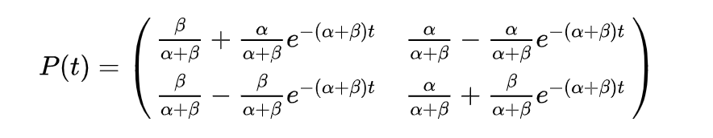
What is an evolutionary model
,
A probabilistic model used to derive probabilities of DNA sequence evolution
Continuous Time Markov Chains
Better known as Markov Models
Use matrices as the physical representation of the probabilities of DNA sequence mutation
These change as time progresses
First computes probability of non-mutation before considering mutations
2 parameters to note:
t – unit of time
μ – mutation rate (sometimes denoted as α or ß)
Mutation rate is sometimes used
Fig 1: An example of a physical representation of a Markov Chain where t is the changing parameter

Slide 9
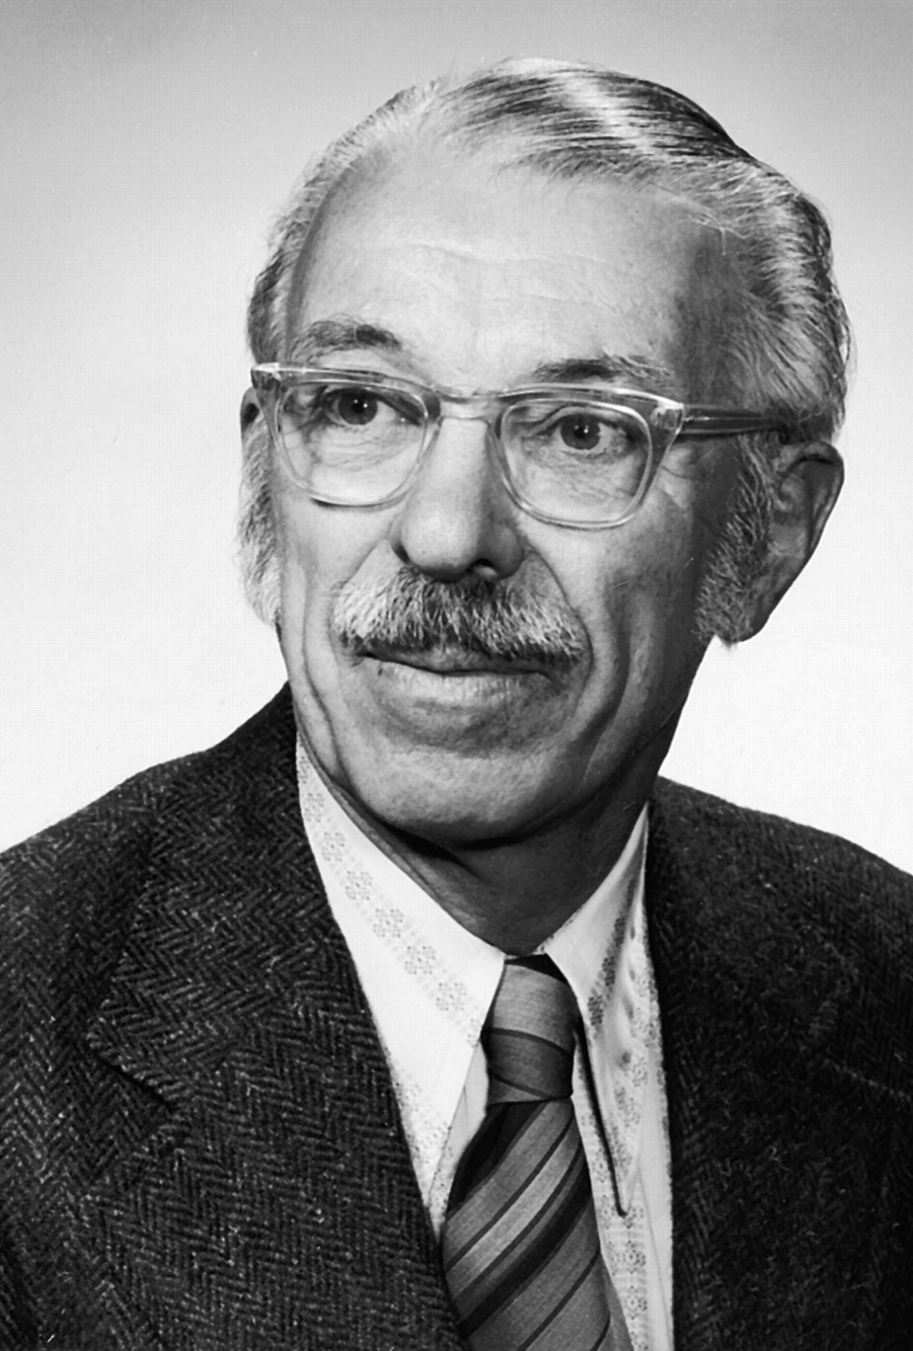

Jukes and cantor 1969 (JC69)
Considered the simplest substitution model
Assumes equal base frequencies $π_{A}=π_{G}=π_{T}=π_{C}= .25$
Also assumes equal mutation rates µ
$P_{ii}=\frac{1}{4}+\frac{3}{4}e^{−tµ}$ (probability of non-mutation)
$P_{ij}=\frac{1}{4}−\frac{1}{4}e^{−tµ}$ (probability of mutation)
As shown, there is a higher probability that a nucleotide base pair will stay the same

Slide 10
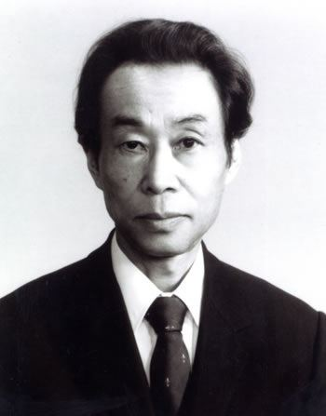
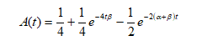
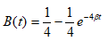
Kimura 2p model (k80)
Important innovation from JC69, has different mutation rates for transitions and transversions
Also assumes equal base frequency
What is a transition and transversion?
Purines (A, G)
Pyrimidines (C, T)
Transition is a mutation from Purine to Purine or Pyrimidine to Pyrimidine
Transversion is a mutation from Purine to Pyrimidine or vice versa
α is the mutation rate for transitions
ß is the mutation rate for transversions, usually anywhere from 2-4 times lower than α
Transversions are known to be less common than transitions
Motoo Kimura
Figure 2: Probability of Transition in K80 model
Figure 3: Probability of Transversion in K80 model

Slide 11
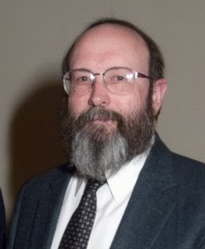

Felsenstein 1981 model (f81)
Incorporates base frequency variation
Base frequencies can vary from .25 (JC69 and K80)
$π_{A} ≠π_{C} ≠π_{T} ≠π_{G} ≠\frac{1}{4}<1$
Base frequency disequilibrium >> fixation
The first model to introduce varying base frequencies
$β=1/(1−π_{A}^{2}−π_{C}^{2}−π_{G}^{2}−π_{T}^{2})$
$P_{ij}\left(t\right)=e^{−βt}+π_{j}(1−e^{−βt})$ if i = j
$P_{ij}\left(t\right)=π_{j}(1−e^{−βt})$ if i ≠ j
Joseph Felsenstein

Slide 12

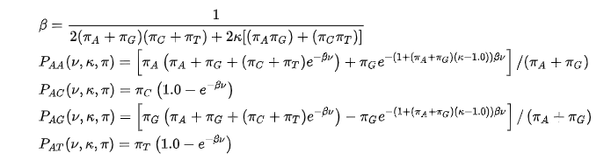
Hasegawa, Kishino, and Yano 1985 Model (HKY85)
Can be thought of as combination of F81 and K80 models
Incorporates different transition and transversion rates (K80)
Incorporates varying base frequencies (F81)
Uses K parameter to distinguish transitions and transversions
Base frequencies are taken from original group of BLAST sequences

Slide 13
Tamura 1992 Model (T92)
Extension of K80 model
Considers GC content bias
The proportion of nucleotides which are G or C
Known to play integral functional role in genome
Useful when there are:
Strong transition and transversion biases
GC content biases
All base frequencies defined as a function of GC content

Slide 14
Repliclade

Slide 15
Introduction to repliclade
Written completely using the Python programming language
Incorporates the Biopython library as well as the numpy library for dealing with DNA sequences and the mathematics behind the evolutionary models, respectively
Utilizes the BLAST algorithm against GenBank to retrieve like sequences to the input sequence
After extracting sequence parameters via user input or probabilistic methods, simulates the ancestral sequence generated via Coalescence Theory
Terminates simulation upon sequence extinction or time exhaustion

Slide 16
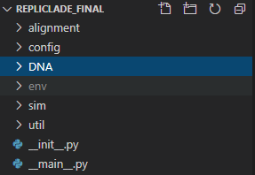
File system
Prompts the user whether they would like to use an input FASTA file which contains a sequence
This FASTA file must go in the “DNA” folder under the root program directory
The “DNA” folder is where the results from BLAST are also returned in XML format
In the config folder there is a config.py file
This file is where the user’s Genbank API credentials will go (to utilize the BLAST algorithm against Genbank)
Under the alignment folder are where the alignment output files are located
Used to display the tree of the alignment
The sim folder houses the simulator.py
The util folder is comprised of multiple utility Python files
Perform the various tasks having to do with DNA sequences and evolutionary models
__main__.py is what kicks off Repliclade

Slide 17
Repliclade – Setting up the simulator
After kicking off the program, Repliclade will ask if you would like to use an input FASTA file
If selected Yes, it will then prompt you for the file name
After the input file is selected, Repliclade will run the input sequence against BLAST and Genbank to retrieve a list of similar sequences to the input sequence
Once the similar sequences are returned in XML format via BLAST on Genbank, Repliclade performs an alignment
The alignment is then displayed as an unrooted Phylogenetic tree

Slide 18
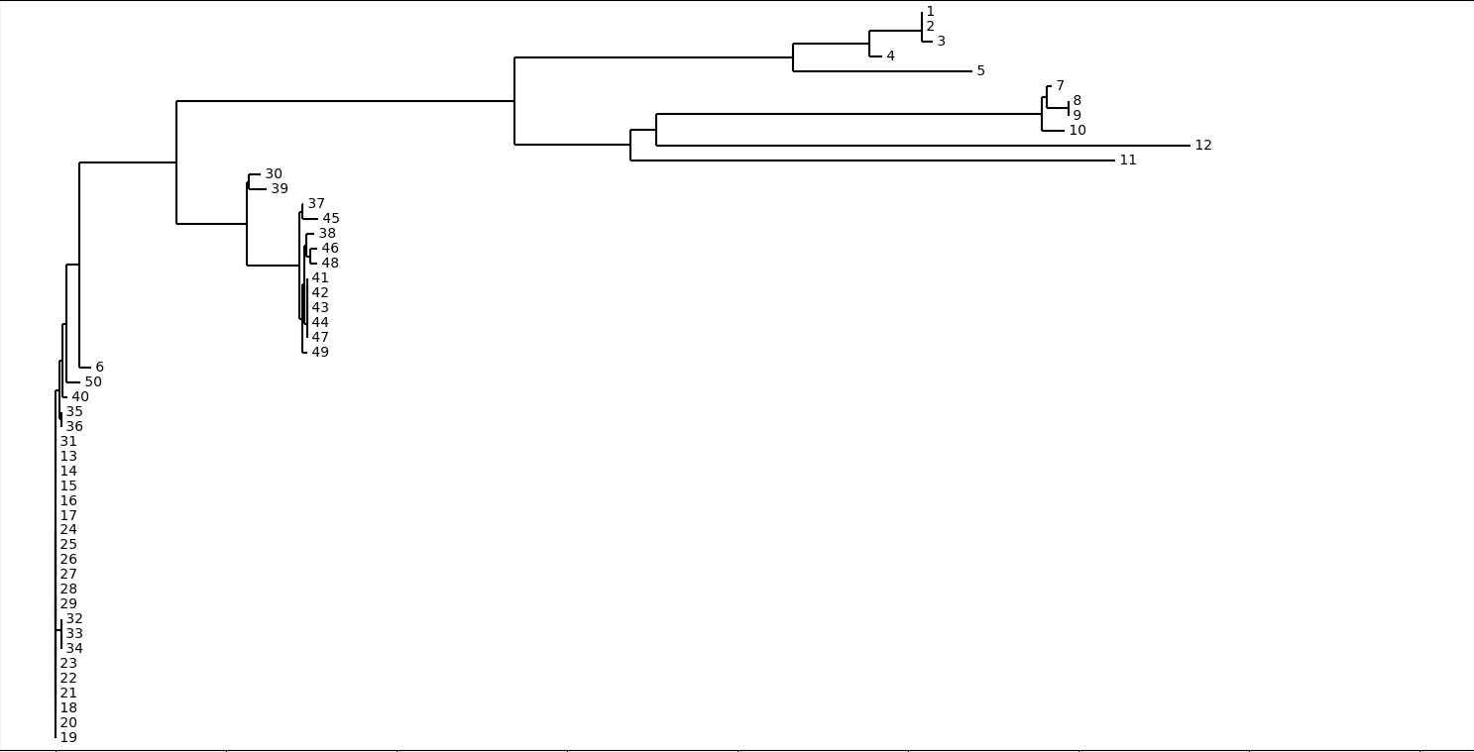
Figure 4: An example of an alignment output in Repliclade on 50 input sequences returned from Genbank via the BLAST algorithm

Slide 19

Repliclade – Sequence parameter extraction
Repliclade provides the user with a series of prompts
These prompts are used to extract sequence parameters
This is a crucial process in Repliclade
Parameters inferred will be useful during the simulation
The thought process behind these extractions discussed in later slides

Slide 20

Importance of aligned sequences
The alignment performed in Repliclade has a very important function
Phylogenetic tree to visualize relationships between various sequences
Provides us with a list of “aligned” sequences
These aligned sequences help us utilize a top-down approach when dealing with sequences
Useful when trying to extract various parameters
Incredibly important when trying to infer an ancestral sequence
“The Coalescent”

Slide 21
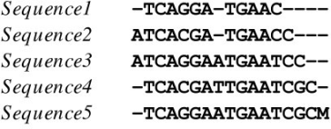
Multiple Sequence alignment - muscle
Repliclade utilizes MUSCLE for Multiple Sequence Alignment
MUltiple Sequence Comparison by Log-Expectation
Created in 2004 by Robert C. Edgar
Considered one of the best modern alignment algorithms
Known to produce better overall alignments
Usually faster and more accurate than Clustal
Repliclade originally used Clustal (Higgins, 1988)
Switched to MUSCLE

Slide 22


Repliclade – Estimating effective population size
Another crucial parameter for Repliclade is the effective population size
Defined as the number of individuals in a population who contribute offspring to the next generation
We will denote the effective population size by $N_{e}$
Considered to be one of the most crucial parameters in Population Genetics and Conservation Biology
To estimate population size, we must be able to satisfy the equation $θ=4N_{e}μ$
µ is the mutation rate
Theta is considered a measure of genetic diversity

Slide 23


Estimating θ – watterson method
Repliclade currently uses a process called the Watterson Method which is used to estimate $θ$
The Watterson Method equation is set up as follows:
$θ_{w}=\frac{K}{α_{n}}$
K is the number of segregating sites
A segregating site is a site in the DNA sequence where the nucleotide base pair differs from one sequence to another or between multiple sequences
$α_{n}$ is the n-1th harmonic number or $\sum_{k=1}^{n−1}{\frac{1}{k}}$
n is the number of sequences
Repliclade determines whether a site is a segregating site using the aligned sequences
Requires a threshold of under 90% to be considered a segregating site across all aligned sequences

Slide 24
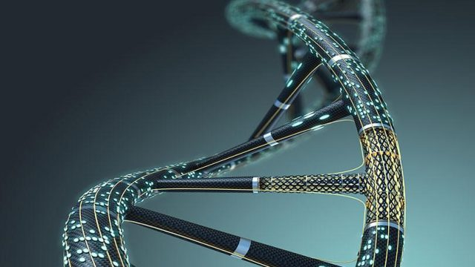

Estimating θ – Fay and wu method
Repliclade also provides Fay and Wu Method for $θ$ estimation
$θ_{H}=(\sum_{i=1}^{n−1}{i^{2}S_{i} ) ∗(\frac{\frac{1}{n\left(n−1\right)}}{2} }$)
n = number of sequences
$S_{i}$ = # of segregating sites where i sequences carry the allele
Allele = base pair/nucleotide
Fay and Wu, 2000

Slide 25


Back to effective population size
Once $θ$ is derived, we can go back to the original equation and figure out the effective population size
The user will get prompted to enter a value for µ or use a default value of 0.00001
Repliclade can now derive $N_{e}$ from:
$N_{e}=\frac{θ}{4μ}$
Repliclade is now able to use $N_{e}$ in its calculations

Slide 26

The coalescent
Often referred to as a “backwards simulation”
Mainly attributed to John Kingman
Used to infer an ancestral sequence from a group of related sequences
Main assumption
The sample size used to perform the backwards simulation is much smaller than the effective population size
This enables us to make educated inferences about population processes
John Kingman, 1982

Slide 27

Repliclade – implementation of coalescent
Repliclade implements a variant of the Coalescent to infer an ancestral sequence
Will then be used for the simulation
The process used in Repliclade is as follows:
Start with i = n lineages/sequences
Choose two sequences at random to coalesce
Merge the two sequences selected and set i = i – 1
If i > 1, keep performing the above steps until an ancestral sequence is derived

Slide 28
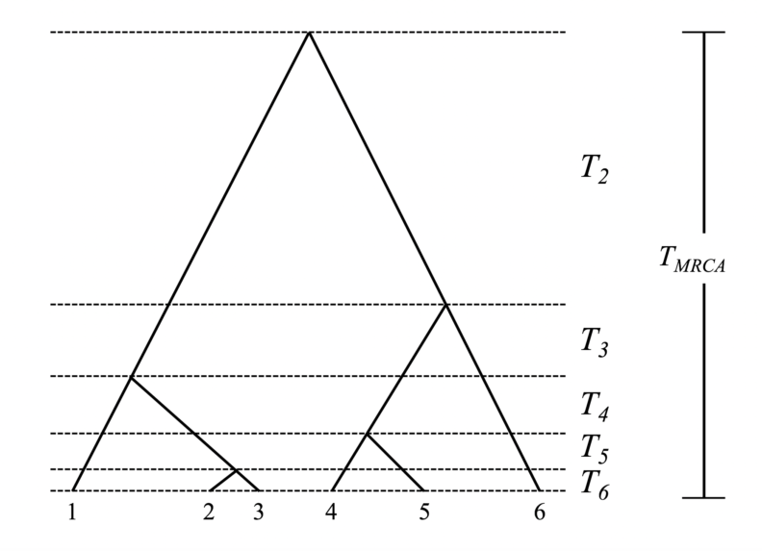

Coalescent – Deep Dive
Randomly choose 2 sequences
Increment generation time i
$P_{c}(i)$ = probability coalescent event occurred i generations ago
$P_{c}\left(i\right)={\left[1−\frac{\left(N_{e}−1\right)}{4}\right]}^{i−1}∗\frac{N_{e}−1}{4}$
$N_{e}$ = effective population size
Ziheng Yang, 2014

Slide 29


Estimation of coalescence time
Using $N_{e}$, Repliclade can estimate an age for the ancestral sequence derived
The assumption of the Coalescent is that with each sequence merge, time for another Coalescent event will get longer
We can now derive the ancestral sequence age by using these simple equations:
Estimate for time to a specific coalescent event $t=\frac{4N_{e}}{i(i−1)}$
i = the current number of sequences left
Estimate for total time to ancestral sequence coalescence then becomes $T=\sum_{k=2}^{i}{\frac{4N_{e}}{k\left(k−1\right)}}$

Slide 30
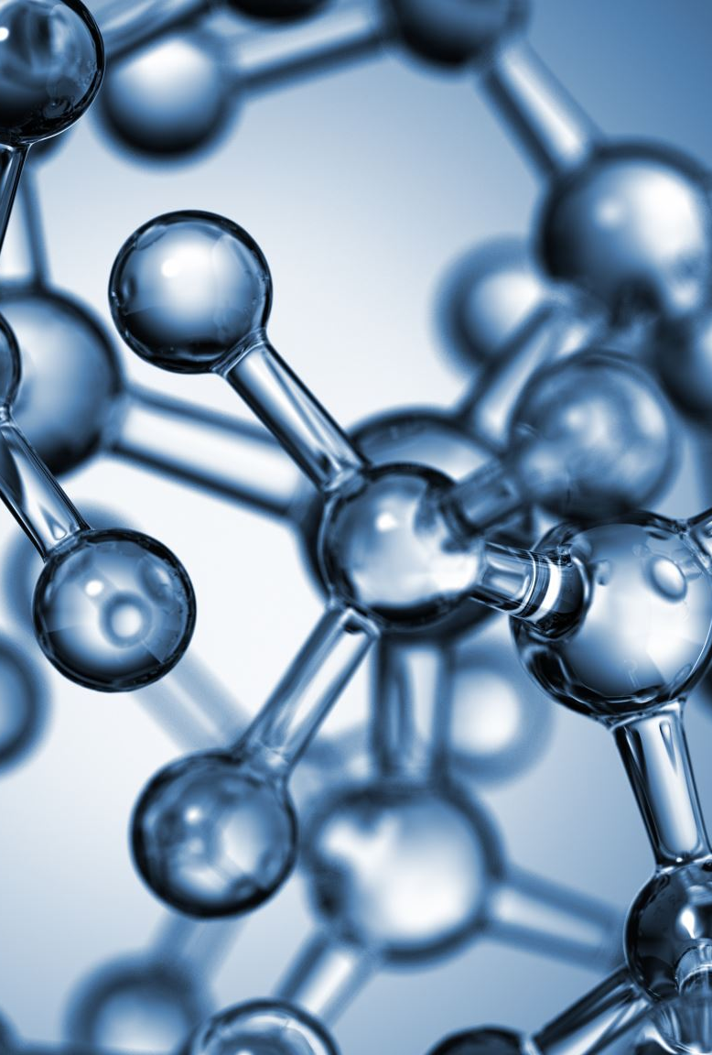

Finding conserved regions – Shannon’s Entropy Score
Repliclade can identify conserved regions within the ancestral sequence
Derived from the original group of sequences
Prompts the user whether they would like to take the conserved regions into consideration for the simulation
Shannon's Entropy Score
Compares to a threshold
$H_{s}=\sum_{i=1}^{n}{P\left(x_{i}\right)logP(x_{i})}$
$P\left(x_{i}\right)$ = Probability of nucleotide occurring at position i across all sequences
Claude Shannon, 1948

Slide 31
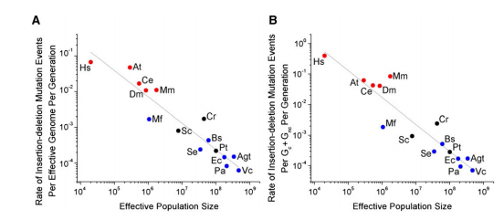
Estimating indel rates
Indels = insertions or deletions in the DNA sequence
E.g. AGTTC becomes ATTC after a deleterious indel
G is removed
Studies show effective population sizes are directly related to indel rates
As effective population size increases, indel rates become lower
Way Sung, Matthew Ackerman, Marcus Dillon, Thomas Platt, Clay Fuqua, Vaughn Cooper, Michael Lynch, 2016

Slide 32
The Simulation

Slide 33

Kicking off the simulation
Repliclade will prompt the user for how many generations they would like to run the simulation for
Repliclade will prompt the user to ask them which evolutionary model they would like to use
Will provide list of available evolutionary models
Then prompts the user whether they would like to consider conserved regions when running the simulation
Also prompts the user for a duplication rate for the DNA sequence

Slide 34

Evolutionary models in the simulator
Evolutionary models are contained as classes in the util folder
evolve.py file
Each model has its own class associated with it
For every sequence, there is an evolutionary model object attached to it
Keeps track of the time elapsed for that specific sequence as well as the current Markov Model associated with the sequence
Since Continuous Time Markov Chains are time dependent
Varied in values depending on when the sequence was duplicated or created
After a sequence is done potentially mutating, the model increments the time variable
Also re-calculates the probability matrix

Slide 35

The simulation process
Simulation will run over the user-specified number of generations
Sequence number can change generation by generation
Due to sequence duplication or extinction
For each sequence in the current generation, a probability for duplication, extinction, and indel events will be calculated
Indel = insertion or deletion in the genome or sequence
Can happen as often as SNP's (Single Nucleotide Polymorphisms or point mutations)

Slide 36

Simulation sequence duplication
Simulator decides to duplicate a sequence
Sequence divergence is tracked in a general tree data structure
Each node is assigned a number
This also determines which sequence came first
Duplication in Repliclade occurs randomly
Duplicated sequences are made children of original sequence nodes

Slide 37

Simulation sequence extinction
As a corollary of duplication, extinction can also happen
Repliclade saves the node within the general tree
Nothing further is done to the sequence
Becomes "Extinct"
Saved within Repliclade for later
Extinction rates are inherently random
No real way to determine extinction computationally

Slide 38
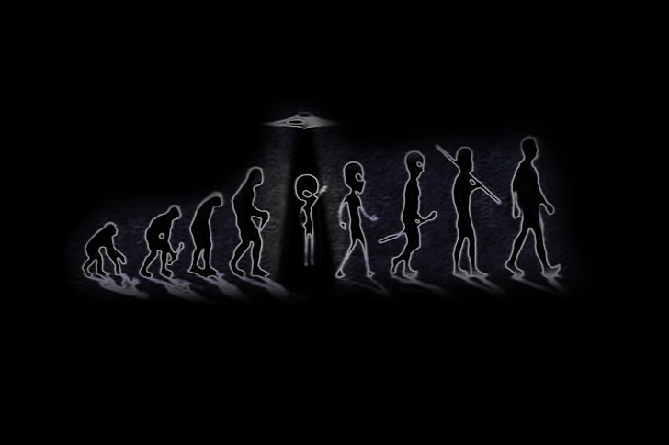
Simulation Iteration process
For each generation, mutation probabilities are calculated
The current sequence in the simulation is ran through the chosen evolutionary model where it will mutate (or not)
If none of the probability rolls for duplication, extinction, and indel events are met
Continue onto next sequence or generation
Each generation is saved to a Python dictionary
The plan is for the user to be able to access each sequence during whichever generation they choose post simulation
To compare results derived during each iteration
Provides the option of saving the Python dictionary to a file in JSON format
Can be used to look at the results later

Slide 39
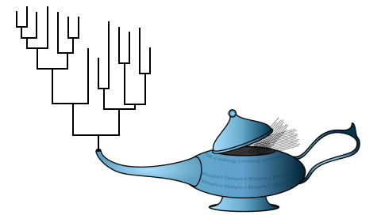
Repliclade - Post simulation
Once generation time has been exhausted, the simulation completes
The simulation sequences and each node are displayed in the console
Enables the user to see the route the simulation took
Saves the nodes and children nodes to a file for use later on
Aligns the sequences via Multiple Sequence Alignment
Prompts the user for tree building methods
Used to build a phylogenetic tree
Uses aligned sequences for phylogenetic inference

Slide 40
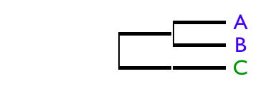
Building phylogenetic tree - upgma
Unweighted pair group method with arithmetic mean
Hierarchical clustering method
Constructs a rooted tree
Constructs distance matrix and does pairwise clustering
Continues until all nodes have been put in the tree
Small example of phylogenetic tree built using the UPGMA algorithm

Slide 41
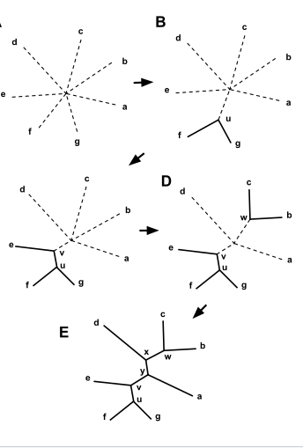
Building phylogenetic tree – neighbor joining (NJ)
Bottom-Up clustering method
Also uses distance matrix as an input
Starts as an unresolved tree
Finds pair of taxa where distance is lowest
Joins the pairs into a connected node which is now considered one node
Continue until all nodes are joined somewhere
Naruya Saitou and Masatoshi Nei, 1987

Slide 42
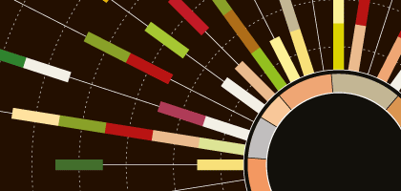
Building phylogenetic tree – maximum parsimony (MP)
Character Based Approach
Infers phylogenetic tree by minimizing the total number of evolutionary changes
Specifically looks at character-based changes
Base pairs/nucleotides
Best tree is “most parsimonious”
Must be found in the tree space (# of possible trees)
A heuristic approach must be used for greater number of taxa
Becomes intractable otherwise

Slide 43

Building phylogenetic tree – maximum likelihood
Given the evolutionary model, provides probabilities of tree topology
Highest probability tree preferred
All possible trees considered
Computationally intense
NP hard
Can become computationally intractable
Heuristic methods are preferred
PhyML

Slide 44
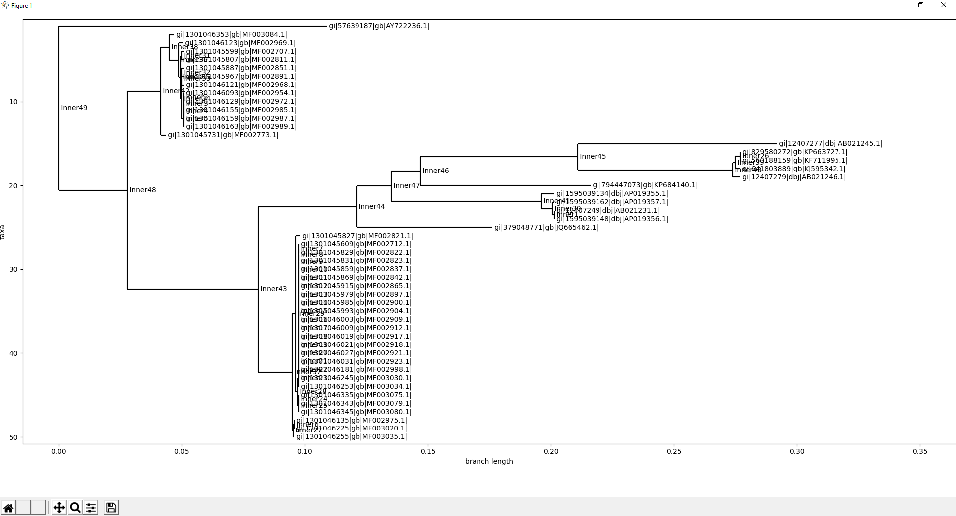
Repliclade - Phylogenetic Tree
Offers user a choice of tree building method
UPGMA
NJ
MP
ML
Displays the phylogenetic tree once the building is complete
MP phylogenetic tree post-alignment

Slide 45
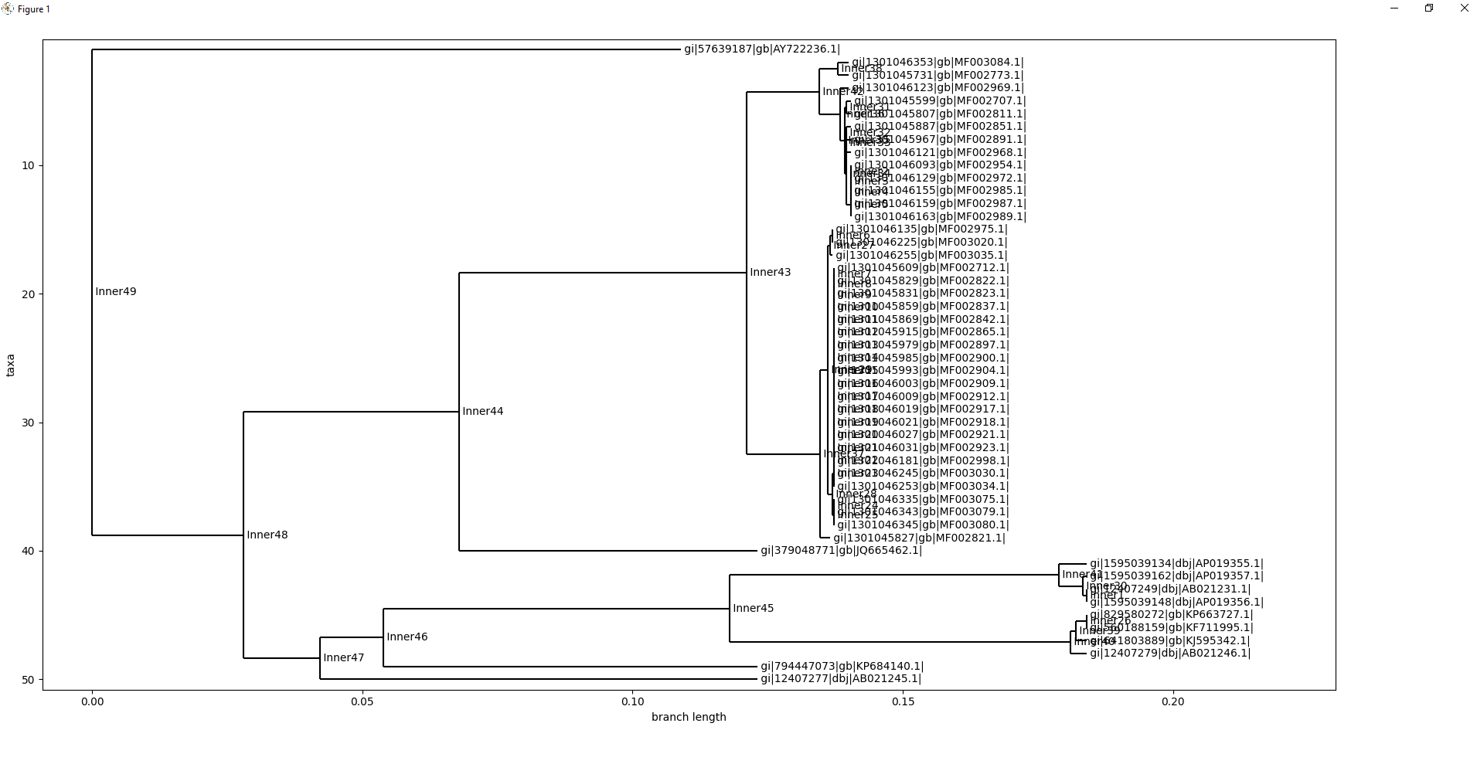
Same tree built using UPGMA

Slide 46
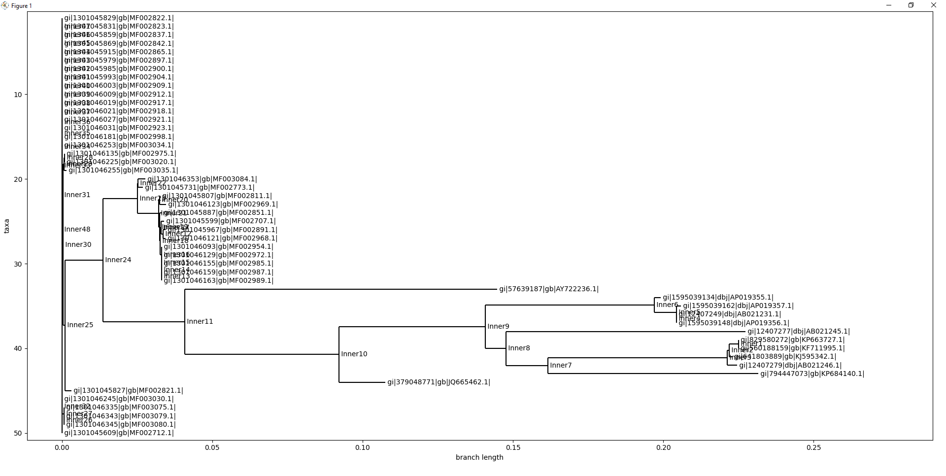
Same tree built using Neighbor Joining

Slide 47
Repliclade - Results

Slide 48
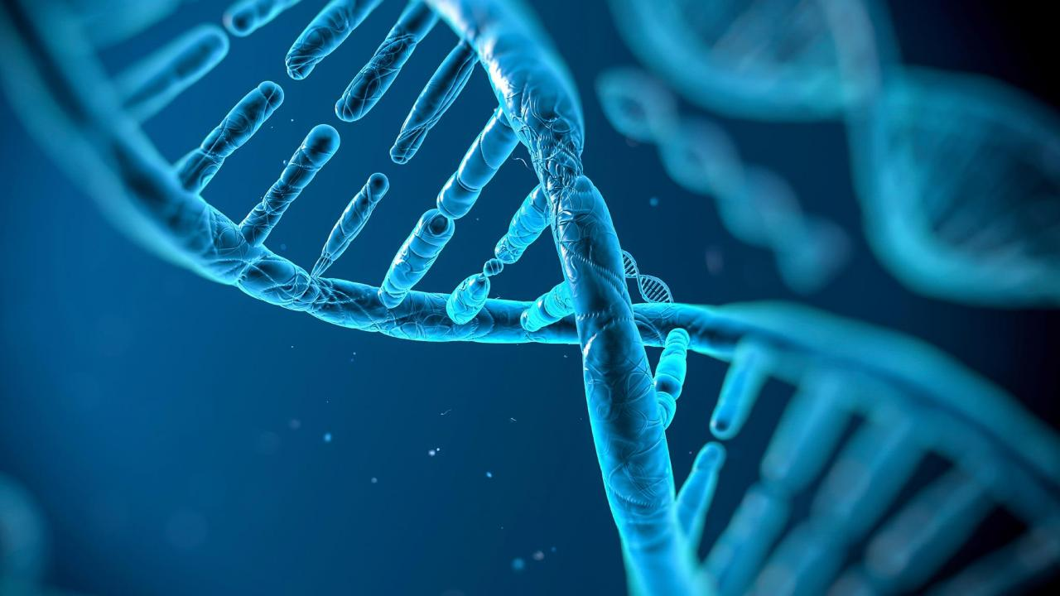
Experiment
Repliclade tested 3 different genes
Cytochrome b
Gene found in mitochondria of eukaryotic cell
Commonly used in phylogenetics
Sequence variability
TNF
Tumor necrosis factor gene
AGP
Glucose-1-phosphatase

Slide 49
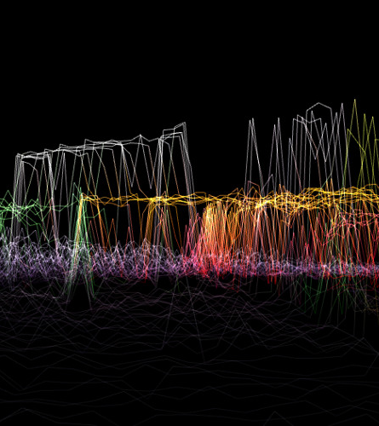

Coalescent results
Performed on all 3 genes 100 times for each evolutionary model
Average times were calculated
HKY85 times are higher
Heavier computationally
More calculations
JC69 has shortest times
Watterson method ($θ$ and $N_{e}$)
Default $μ$ value used (0.00001)

Slide 50
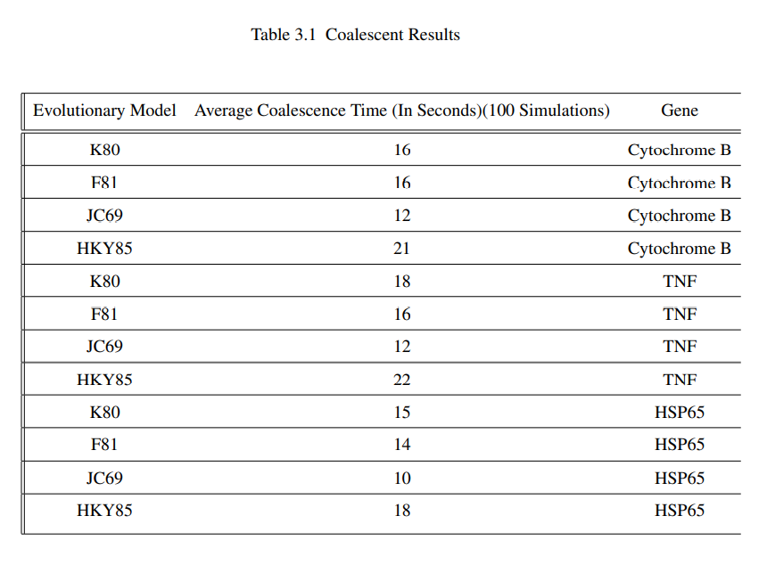

Slide 51

Simulation of evolution
Ancestral sequence derived used for simulation
Generations set to 50,000
Speedy
No conserved regions or deletions
Insertions and SNP’s
Each gene simulated 100 times
Same 4 evolutionary models as Coalescent results
Total 400 simulations for each gene
All run on 50,000 generations

Slide 52
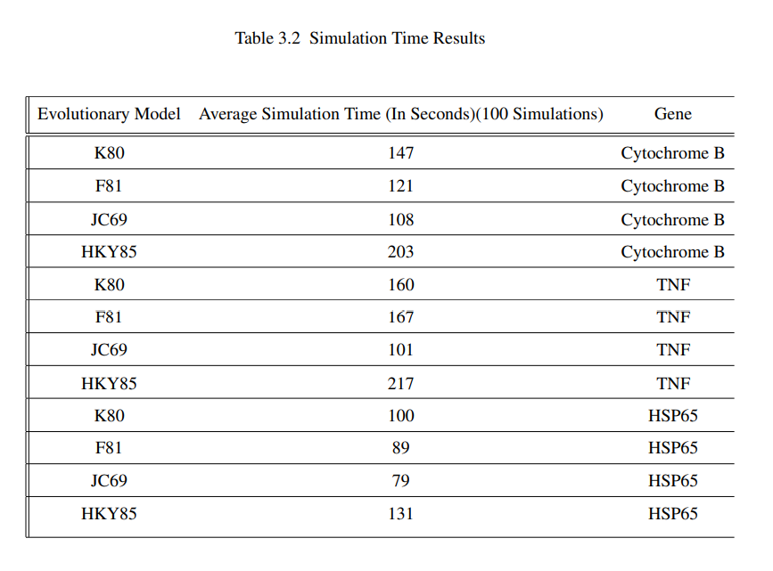

Slide 53
Phylogenetic reconstruction
Sequences are aligned post-simulation (MUSCLE)
All 4 phylogenetic reconstruction methods used
NJ
UPGMA
MP
ML
PhyML used for ML reconstruction
Each reconstruction saved to Repliclade File System
As well as “true tree”

Slide 54
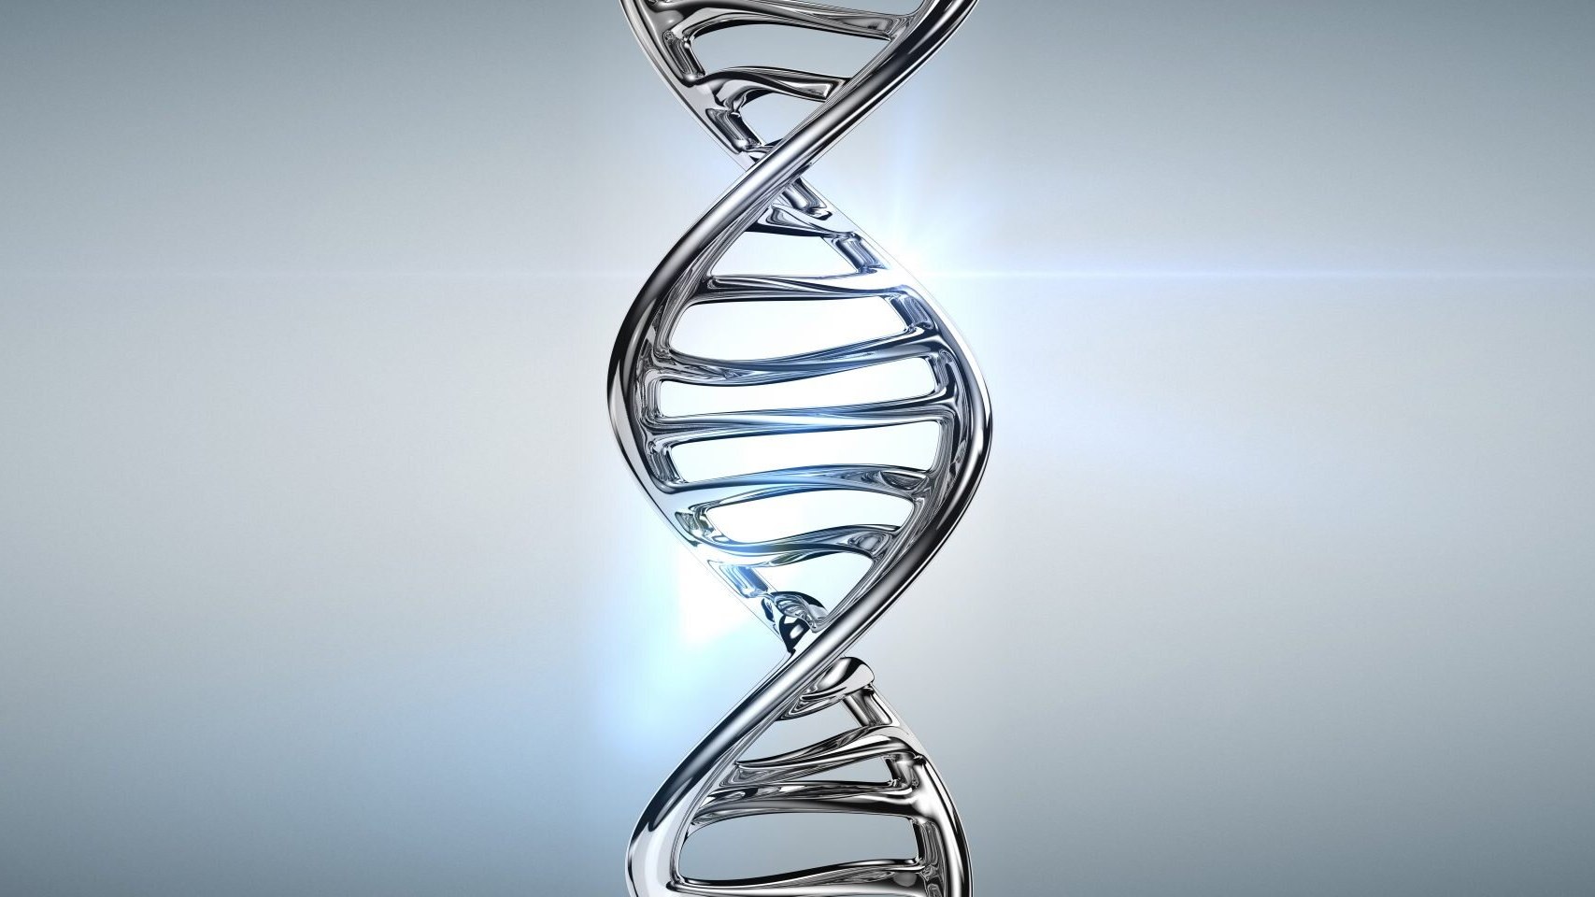
Phylogenetic reconstruction similarity scores
Python utility file
repliclade_insights.py
Used to process phylogenetic trees
Generates similarity scores to “true trees”
Multiple characteristics evaluated
Terminal nodes (leaf nodes)
Non-Terminal nodes (non-leaf nodes)
Pre-Terminal nodes (parent nodes of terminal nodes)
Interior Branch Test
Scores are summed up
Each gene and evolutionary model

Slide 55
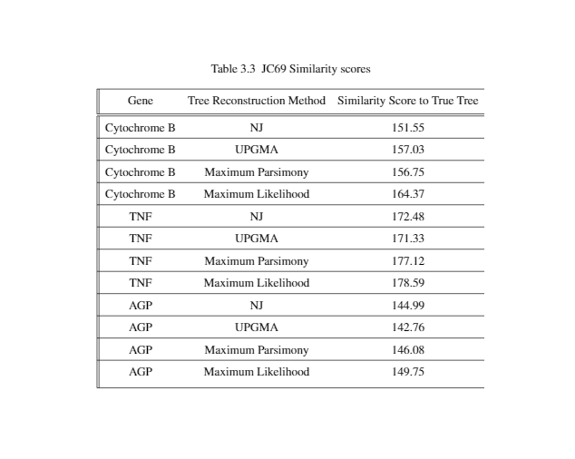

Slide 56
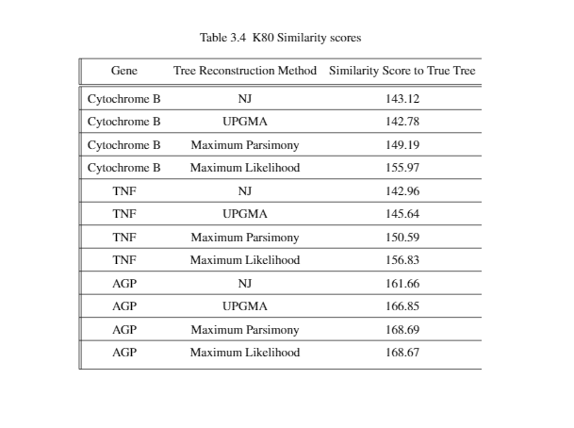

Slide 57
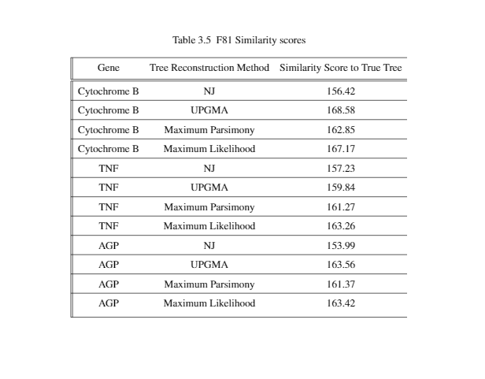

Slide 58
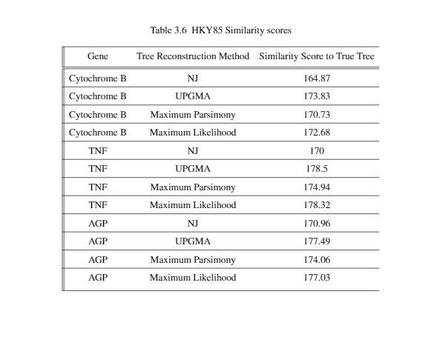

Slide 59
Discussion

Slide 60
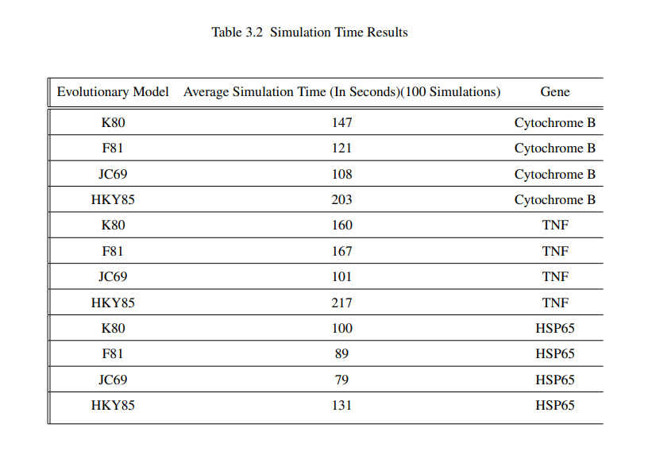
Simulation Results
Average time is used
Randomness of simulation skews singular runtime results
HKY85 averaged higher
Computation complexity
No unexpected results
Model complexity influences simulation runtime

Slide 61
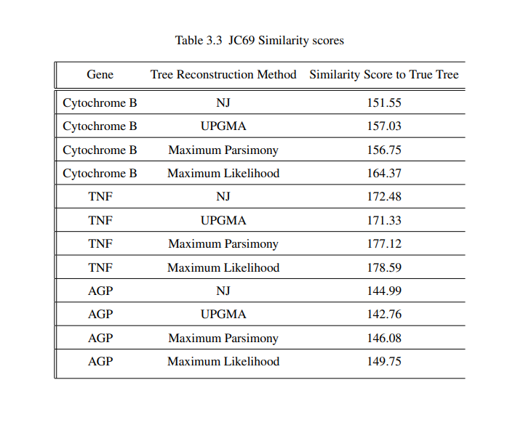

JC69 Similarity Scores
Assumption: less evolutionary similarity $≈$ lower score
Exception is TNF gene
TNF $≈$ higher similarity scores
All reconstruction methods
Strengthens case for JC69 + TNF
Previous studies JC69 + TNF (Mathew et al., 2013)
AGP $≈$ lower similarity scores
Suggests constraints on its evolution
May not be well reflected with JC69

Slide 62

K80 Similarity scores
K80 more closely resembles evolutionary forces
We expect to see higher similarity scores than JC69
Yielded poorer performance than JC69
Exception is AGP
Underscores importance of model performance before intensive phylogenetic analysis (Collins et al., 2012)
AGP may adhere to Ti/Tv rates to anticipated values in K80
Phylogenetic tree reconstruction may have resembled that bias

Slide 63
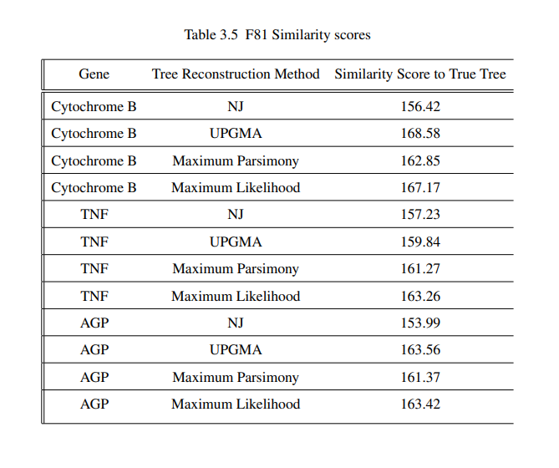
F81 similarity scores
Incorporates base frequencies
Base frequencies of original homologous sequences
Consistency across all genes and tree reconstruction methods
Could be attributed to base frequencies
Previous studies show interplay between base frequencies and population dynamics (Knudson et al., 2005)
Highest similarity score for Cyt B and UPGMA
Deviates from pattern that ML outperforms distance based algorithms (Whelan et al., 2001)
May be related to Cyt B being mitochrondrial gene
Evolves more rapidly (Brown et al., 1982)
Distance based algos may be more efficient in mitochondrial phylogenies

Slide 64
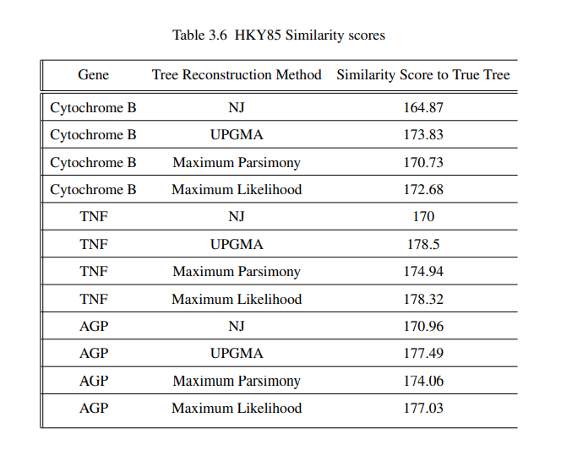
HKY85 similarity scores
HKY85 incorporates base frequencies + Ti/Tv ratios
Shows average higher score for all algos
Aligns with previous studies (Yang, 1993)
Due to strengths of K80 + F81 models
UPGMA outperformed other algorithms for all genes
Similar to F81 and Cyt B
ML was incredibly close to UPGMA scores
Consistent with previous studies
Base frequency consideration and randomized processes in a group of sequences can obscure phylogenetic reconstruction accuracy (Davalos et al., 2008)

Slide 65
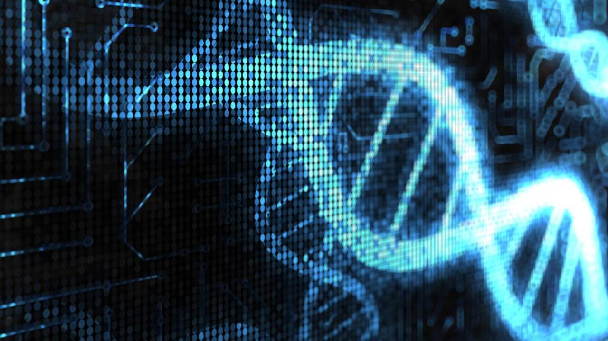
Conclusion
Repliclade provides a novel resource for biological researchers
Enables them to assess various methods for suitability
Repliclade supports multiple:
Evolutionary models
Phylogenetic inference methods
Incorporates well-vetted methodologies for:
Sequence parameter extraction
The Coalescent Process
Repliclade incorporates repliclade_insights.py
Scores reconstructed phylogenies
Compared to true tree
These score provide insight into the efficacy of certain models
In regards to an input sequence/gene

Slide 66


Future Directions
Repliclade could incorporate more tree building algorithms and evolutionary models
Especially the GTR (General Time Reversible) evolutionary model
Future analyses could be performed on a broader range of DNA sequences
Incorporate more phylogenetic inference methods
Bayesian analysis
Deletions and conserved regions could be considered
Repliclade could incorporate other methods of tree similarity scoring
Bootstrap methods
Utilize other methods of sequence parameter extraction
$θ, N_{e}$
Expand performance testing
Fully integrate with another software package developed in the Kuzoff Lab
Clade Runner
Hope to do each of these things
As my advisor and I pursue publication of this body of work

Slide 67
Special Thank you
To Professor Kuzoff, my thesis advisor
To the thesis defense committee, Professor Arnab Ganguly and Professor Christopher Veldkamp
To the Computer Science faculty at UWW
To my wife and parents
To my colleagues in the Master’s program

